Slide 1

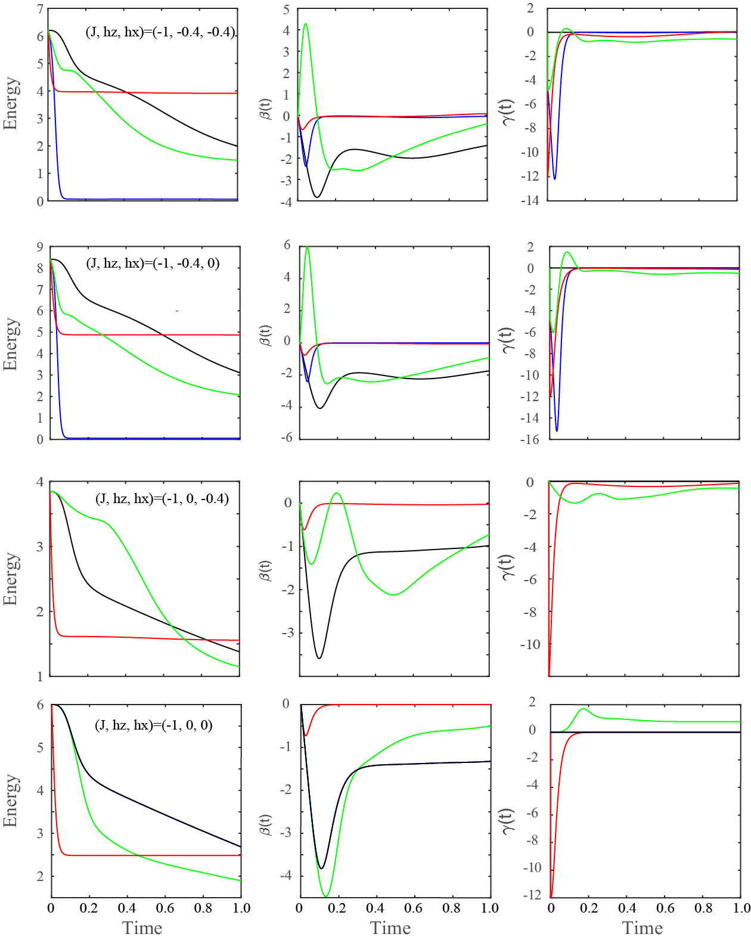
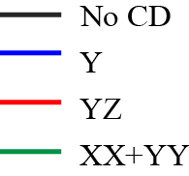
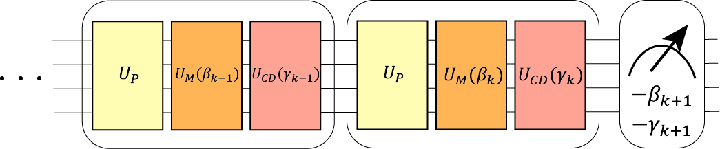

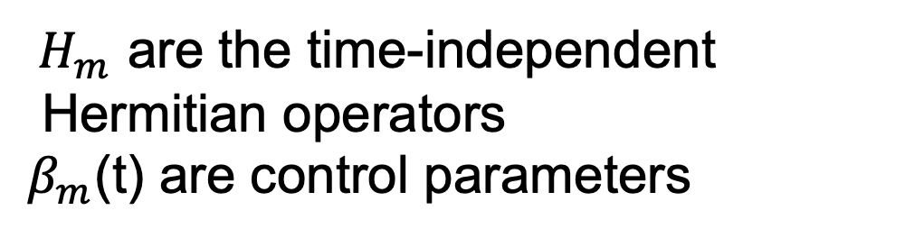
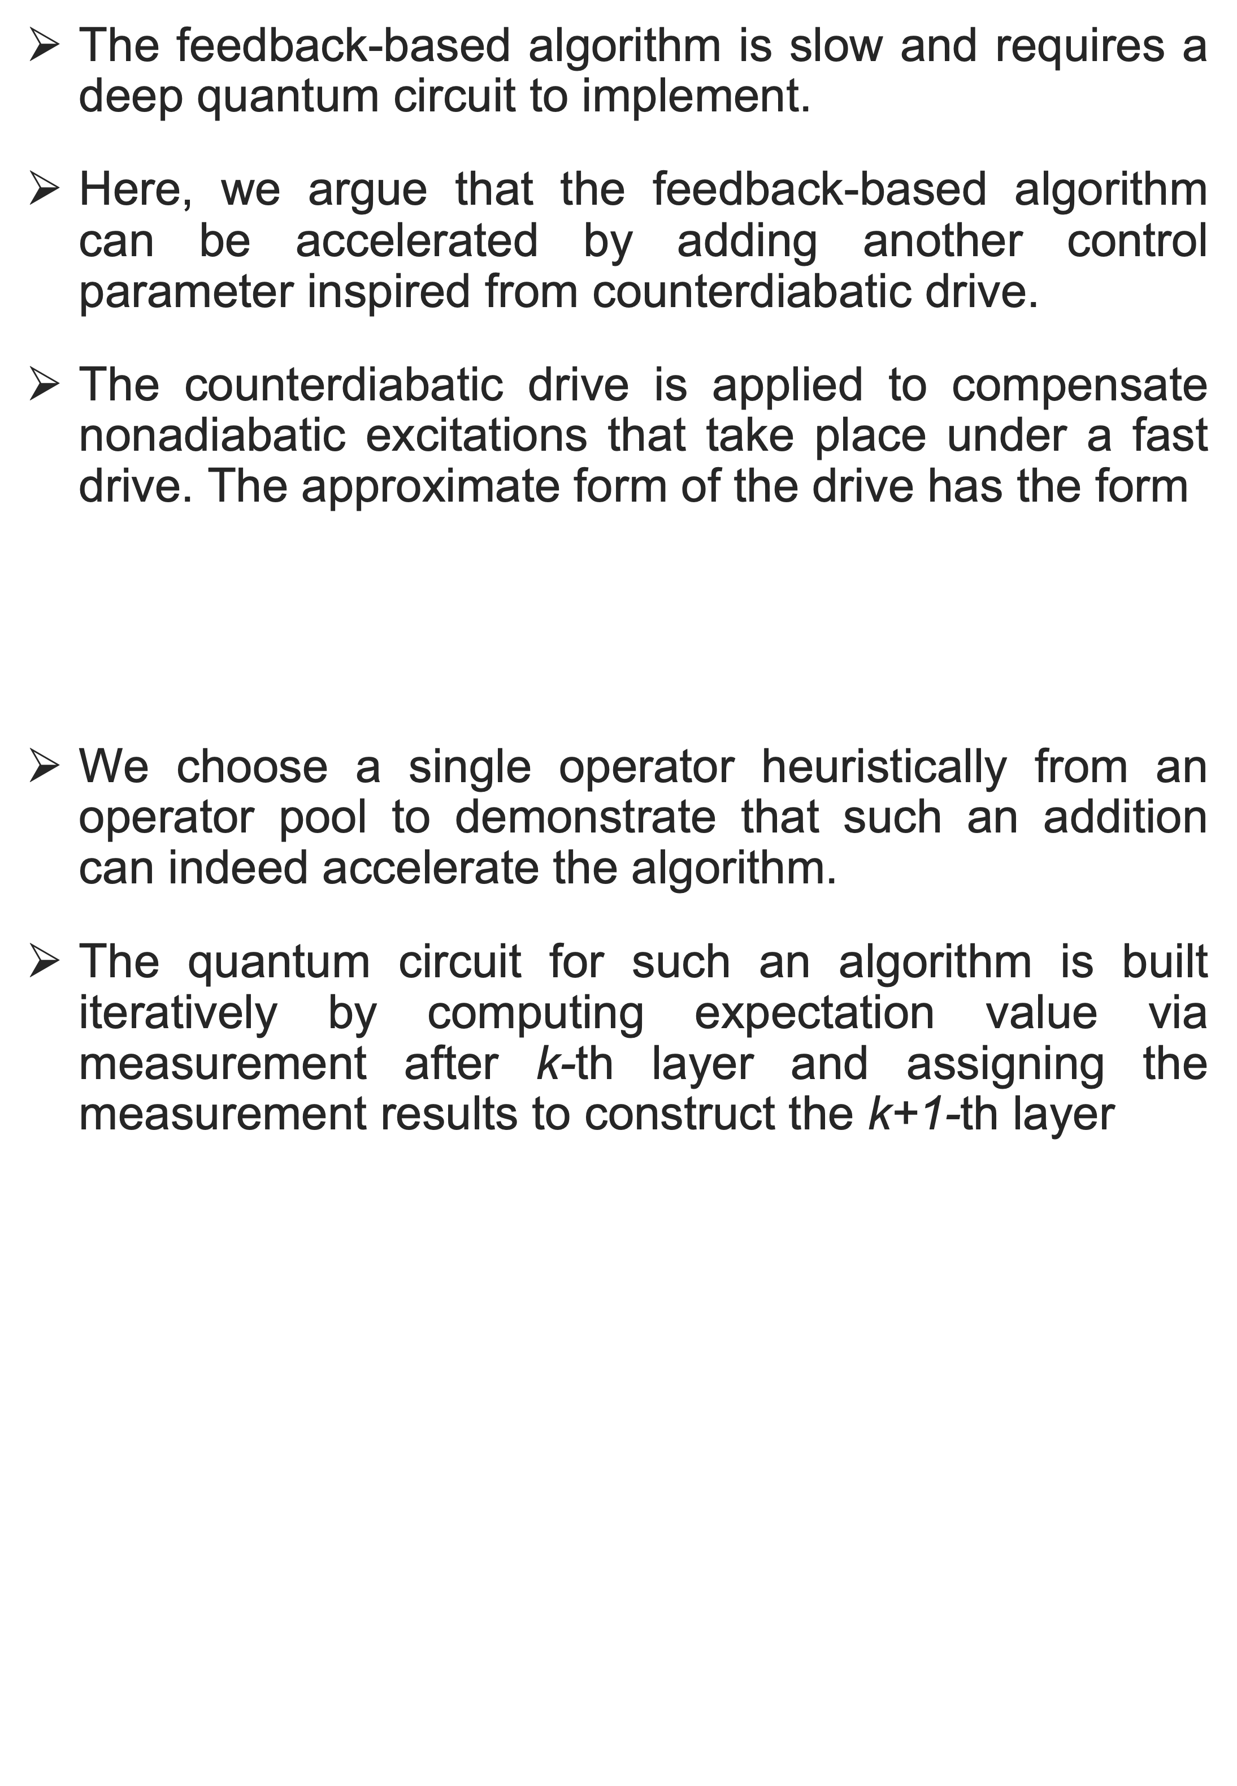






Poster Title: Arial Bold 96pt, left-aligned Two lines, if needed
Feedback-based quantum algorithm inspired by Counterdiabatic Driving
Rajesh K. Malla¹, Hiroki Sukeno² , Hongye Yu², Andreas Weichselbaum¹, Tzu-Chieh Wei²,
and Robert M. Konik¹
¹ Brookhaven National Laboratory, ² Stony Brook University
Author(s) Name(s): Arial 48pt, left-aligned
Two lines, if needed
Scientific background
Results
The feedback-based quantum algorithm is a “fully quantum” algorithm that uses a quantum control method to design quantum circuits.
This can be used to prepare the ground state of a quantum many-body system as well as solve combinatorial optimization problems.
The equation of motion:
The goal is to find a time-evolution that ensures that the average energy decreases with increasing time
By assigning $β_{m}\left(t\right)=−i<ψ\left(t\right)\left|\left[H_{m},H_{P}\right]\right|ψ\left(t\right)>,$ one can ensure that the energy decreases.
In Ref. [1], it was demonstrated for combinatorial optimization problem with a single control Hamiltonian.
Hamiltonian:
For simplicity we choose $J_{ij}=J,h_{i}=h_{z},k_{i}$= $h_{x}$, and periodic boundary condition
$H_{m}$ are the time-independent
Hermitian operators
$β_{m}$(t) are control parameters
$≤$ 0
Motivation and the algorithm
The feedback-based algorithm is slow and requires a deep quantum circuit to implement.
Here, we argue that the feedback-based algorithm can be accelerated by adding another control parameter inspired from counterdiabatic drive.
The counterdiabatic drive is applied to compensate nonadiabatic excitations that take place under a fast drive. The approximate form of the drive has the form
We choose a single operator heuristically from an operator pool to demonstrate that such an addition can indeed accelerate the algorithm.
The quantum circuit for such an algorithm is built iteratively by computing expectation value via measurement after k-th layer and assigning the measurement results to construct the k+1-th layer
Conclusions
We observe that indeed adding an additional control parameter inspired by the counterdiabatic drive can accelerate the feedback-based algorithm.
However, for certain Hamiltonian this comes at a cost of not reaching the ground state. Such problems can be avoided using proper perturbations.
Nevertheless, for small enough system size the addition of CD operator increases the ground state probability for small circuit depth.
* This work was supported by the U.S. Department of Energy, Office of Basic Energy Sciences, under Contract No. DE-SC0012704.
References
$$U_{P}=e^{−iH_{P}∆t}$$
1. A. B. Magann, K. M. Rudinger, M. D. Grace, and M. Sarovar, Phys. Rev. Lett. 129, 250502 (2022).
2. Malla et al., (To be posted in Arxiv)
$$U_{CD}=e^{−i{γ_{k}H}_{CD}∆t}$$
$$U_{M}=e^{−iβ_{k}H_{M}∆t}$$
$∆t$ is the free parameter

